Slide 1
Helpfulness Prediction of Product Reviews using Machine Learning
Amrita School of Engineering, Bangalore
Presented By Guided By
Kagolanu Trishul Dr. Srinath R. Naidu
BL.EN.P2CSE17013 Associate Professor(CSE dept)

Slide 2
Presentation Outline
Introduction
Motivation
Problem Statement
Literature review
Summary of literature review
Research Gaps and Challenges Addressed
Architecture diagram of implementation
Implementation
Conclusions
References
Status of Minor & Major project papers

Slide 3
Introduction
In various platforms such as e-commerce customers express their opinion through reviews
These reviews are taken as a reference by potential customers to make a purchase decision
In general, there is an option for the customer to vote whether a review was helpful or not.

Slide 4
Motivation
Large Number of Reviews
Often it is difficult for a customer to read through all the reviews
It is important to determine the helpfulness of a review and make the most helpful reviews accessible to the customers

Slide 5
Problem Statement
Develop a System to predict the helpfulness of a review using Machine Learning.

Slide 6
Summary of Literature Survey
The process of helpfulness prediction can be divided into four phases
Data Collection
Feature Extraction
Prediction – Regression vs Classification
Evaluation
In general, the features required for predicting helpfulness are extracted from the review text, reviewer and review metadata.
Helpfulness prediction can be taken as a regression problem or classification problem or a combination of both.
Machine learning algorithms for regression and classification are applied to predict helpfulness.

Slide 7
Research Gaps and Challenges Addressed
Features need to be extracted from all three categories: Reviewer, Review Text and Review Metadata. Not only from a single category or a combination of any two.
Further features can be extracted within these categories.
Methods on what review tells about the aspects of the product can be explored.
The relation among the review variables can be analyzed.
Prediction methods involving machine learning can consider further algorithms like Ensemble methods.
The time of the review posting needs to be considered.
The dataset size considered in these cases were of maximum 3 Lakh in size. In general in a real scenario, the data will be huge. This needs to be handled with better technology and algorithms.

Slide 8
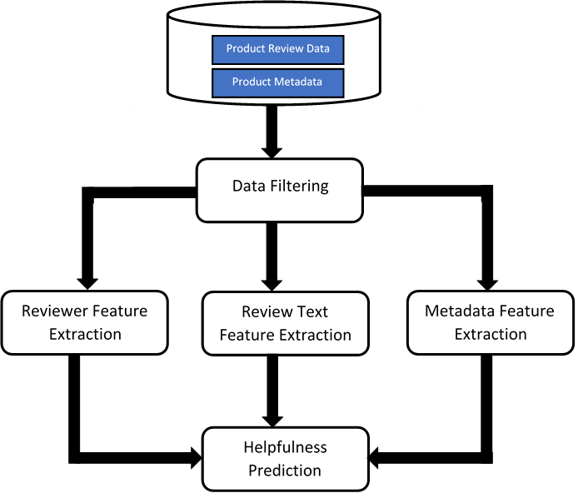
Architecture Diagram of Implementation

Slide 9
Implementation
Data Collection
Amazon Reviews Data
Collected From : http://jmcauley.ucsd.edu/data/amazon
>= 10 votes
Categorized the features into Reviewer, Review Text & Review Meta Data
Linear Regression, Random Forests, Extreme Gradient Boosting, XGBoost with customized Grid Search used for prediction

Slide 10
Implementation
Reviewer | Review Text | Review Metadata
User Average Rating Deviation User Average Delay User Days No of Reviews | Difficult Words Positive Words Negative Words Review Length Sentence Count Words Per Sentence SMOG Index Flesch Reading Ease Coleman-Liau Index Automated Readability Index Gunning fog Dale Chall Readability Score Flesch-Kincaid Grade Level Linsear Write Formula | Stem Sim Length Lem Sim Length Rating

Slide 11
Implementation
Feature-wise Results
MAE Top-10 Features
RMSE Top-10 Features

Slide 12
Implementation
Category-wise Results

Slide 13
Implementation
All Feature Model-wise Results

Slide 14
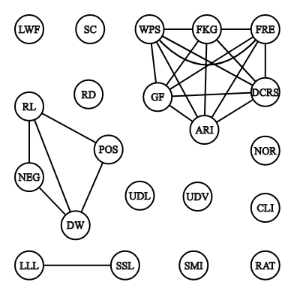
Implementation
Inter-feature Correlation Graph

Slide 15
Implementation
No of Features after feature reduction : 13
Feature-set reduction : 38%
RMSE : 0.1924
MAE : 0.1323
Reviewer | Review Text | Review Metadata
User Average Rating Deviation User Average Delay User Days No of Reviews | SMOG Index Words per Sentence Coleman-Liau Index Linsear write formula Sentence Count Positive Words Negative Words | Rating lem sim length

Slide 16
Conclusions
Developed a system to automatically predict helpfulness
Categorized the features into Reviewer, Review Text & Review Meta Data
Rating of a review showed the highest impact on helpfulness followed by Positive words , Difficult words, User Rating Deviation, Length ,Stem Sim Length & Lem Sim Length
Meta Data Category showed the best performance of all categories
Extreme Gradient Boosting with customized Grid Search gave the Best Results in predicting helpfulness
Feature-set Size Reduction was achieved using Inter-feature Correlation Graph without significant increase in error

Slide 17
References
1. Malik, M. S. I. and Ayyaz Hussain. “An analysis of review content and reviewer variables that contribute to review helpfulness.” Inf. Process. Manage. 54 (2018): 88-104.
2. Saumya, Sunil, Jyoti Prakash Singh, Abdullah M. Baabdullah, Nripendra P. Rana and Yogesh Kumar Dwivedi. “Ranking online consumer reviews.” Electronic Commerce Research and Applications 29 (2018): 78-89.
3. Park, Yoon-Joo “Predicting the Helpfulness of Online Customer Reviews across Different Product Types”, Sustainability, (2018), 10. 1735.
4. Y.K. Chua, Alton & Banerjee, Snehasish “Helpfulness of user-generated reviews as a function of review sentiment, product type and information quality”, Computers in Human Behavior, (2016) ,54. 547-554.
5. Y. Zhang and D. Zhang, "Automatically predicting the helpfulness of online reviews," Proceedings of the 2014 IEEE 15th International Conference on Information Reuse and Integration (IEEE IRI 2014), Redwood City, CA, 2014, pp. 662-668.
6. Mudambi, S. M., & Schuff, D. “What makes a helpful review? A study of customer reviews on Amazon. com.”, MIS Quarterly, 2010, 34(1), 185–200.

Slide 18
References
7. Y. Liu, X. Huang, A. An and X. Yu, "HelpMeter: A Nonlinear Model for Predicting the Helpfulness of Online Reviews," 2008 IEEE/WIC/ACM International Conference on Web Intelligence and Intelligent Agent Technology, Sydney, NSW, 2008, pp. 793-796.
8. R. He, J. McAuley. Modeling the visual evolution of fashion trends with one-class collaborative filtering. WWW, 2016
9. J. McAuley, C. Targett, J. Shi, A. van den Hengel. Image-based recommendations on styles and substitutes. SIGIR, 2015
10. Merton, R.K., The Matthew effect in science: the reward and communication systems of science are considered. Science 159 (3810), 1968, 56–63.
11. Kim, S.M.; Pantel, P.; Chklovski, T.; Pennacchiotti, M. Automatically assessing review helpfulness.In Proceedings of the 2006 Conference on Empirical Methods in Natural Language Processing, Sydney, Australia, 22–23 July 2006; pp. 423–430.

Slide 19
References
12. A. Mukherjee, V. Venkataraman, B. Liu, and N. Glance, “What yelp fake review filter might be doing?” 2014.
13. X. Li, L. Xie, F. Zhang and H. Wang, "Online Deceptive Product Review Detection Leveraging Word Embedding," 2017 IEEE 15th Intl Conf on Dependable, Autonomic and Secure Computing, 15th Intl Conf on Pervasive Intelligence and Computing, 3rd Intl Conf on Big Data Intelligence and Computing and Cyber Science and Technology Congress(DASC/PiCom/DataCom/CyberSciTech), Orlando, FL, 2017, pp. 867-870.
14. Minqing Hu and Bing Liu. "Mining and Summarizing Customer Reviews." Proceedings of the ACM SIGKDD International Conference on Knowledge Discovery and Data Mining (KDD-2004), Seattle, Washington, USA, Aug 22-25, 2004.
15. Bing Liu, Minqing Hu and Junsheng Cheng. "Opinion Observer: Analyzing and Comparing Opinions on the Web." Proceedings of the 14th International World Wide Web conference (WWW-2005), Chiba, Japan, May 10-14, 2005.
16. Pedregosa F. , Varoquaux G. , Gramfort A. , Michel V., Thirion B. , Grisel O. , Blondel M. , Prettenhofer P. , Weiss R. , Dubourg V. , V,erplas J. , Passos A. , Cournapeau D. , Brucher M. , Perrot M. , Duchesnay E.,"Scikit-learn: Machine Learning in Python", Journal of Machine Learning Research, Volume 12, 2825-2830, 2011

Slide 20
References
17. Wikipedia contributors. SMOG. In Wikipedia, The Free Encyclopedia. Retrieved 07:55, December 12, 2018, from https://en.wikipedia.org/w/index.php?title=SMOG&oldid=838363055, (April 26, 2018)
18. Wikipedia contributors, Flesch–Kincaid readability tests. In Wikipedia, The Free Encyclopedia. Retrieved 07:58, December 12, 2018, from https://en.wikipedia.org/w/index.php?title=Flesch%E2%80%93Kincaid_readability_tests&oldid=872588092,(December 7, 2018).
19. Wikipedia contributors, Coleman–Liau index. In Wikipedia, The Free Encyclopedia. Retrieved 07:59, December 12, 2018, from https://en.wikipedia.org/w/index.php?title=Coleman%E2%80%93Liau_index&oldid=758752161, (January 7, 2018).
20. Wikipedia contributors, Gunning fog index. In Wikipedia, The Free Encyclopedia. Retrieved 08:00, December 12, 2018, from https://en.wikipedia.org/w/index.php?title=Gunning_fog_index&oldid=840475093, (May 10, 2018).
21. Wikipedia contributors, Dale–Chall readability formula. In Wikipedia, The Free Encyclopedia. Retrieved 08:01, December 12, 2018, from https://en.wikipedia.org/w/index.php?title=Dale%E2%80%93Chall_readability_formula&oldid=872564618, (December 7, 2018).

Slide 21
References
22. Wikipedia contributors, Automated readability index. In Wikipedia, The Free Encyclopedia. Retrieved 08:12, December 12, 2018, from https://en.wikipedia.org/w/index.php?title=Automated_readability_index&oldid=856199533,(August 23, 2018).
23. Eltorai, Adam & S Naqvi, Syed & Ghanian, Soha & Eberson, Craig & Weiss, Arnold Peter & Born, Christopher & Daniels, Alan, "Readability of Invasive Procedure Consent Forms", Clinical and translational science,2015.
24. Pandey S., M S., Shrivastava A., “Data Classification Using Machine Learning Approach”, In: Thampi S., Mitra S., Mukhopadhyay J., Li KC., James A., Berretti S. (eds) Intelligent Systems Technologies and Applications. ISTA 2017. Advances in Intelligent Systems and Computing, vol 683. Springer, Cham, 2018.
25. V. Vishagini and A. K. Rajan, "An Improved Spam Detection Method with Weighted Support Vector Machine," 2018 International Conference on Data Science and Engineering (ICDSE), Kochi, pp. 1-5, 2018.

Slide 22
Status of Minor & Major Projects
Minor Project
Status : Presented
Conference : International Conference on Engineering, Technology and Management in the Digital Era (ICETMDE-19)
Major Project
Status : Under Progress

Slide 23
THANK YOU

